Slide 1
Welcome to all to weekly sientific seminar

Slide 2
TOPIC
Management of diabetes mellitus
in
Hospital setting

Slide 3
SPEAKER
DR MOHAMMAD MOMINUL ISLAM FAkIR
INDOOR MEDICAL OFFICER
DEPARTMENT OF ENDOCRINOLOGY AND METABOLISM
RANGPUR MEDICAL COLLEGE HOSPITAL

Slide 4
epidemiology
Diabetes is a major pubhealth issue not only in bangladesh but also in the world.
It is one of the most common non-communicable disease globally.
Diabetes mellitus is one of the important comorbid condition of many diseases in our body.
Untreated and uncontrolled diabetes mellitus may lead to various micro and macrovascullar complications.

Slide 5
Global trend
Total number of diabetic people nearly 537 million.
Every 10 seconds 2 people develop diabetes.
10.5 % of adult population (20-79 years)
7th leading cause of death.
Diabetes kills 1 person in every 8 second.
10 % of global health expenditure.
By 2030 it will be projected to 643 million and By 2045 it will be projected to 783 million.

Slide 6
Bangladesh trend
Total number of diabetic people nearly 13.1 million.
14.2 % of adult population (20-79 years).
8th position in the world now a day.
1 in 6 birth is affected in mother with high blood glucose.
By 2045 it will be projected to 7th position with 22.3 million people.
so it is burning and alarming issue.

Slide 7
Categories of patients with dysglycaemia in hospital setting
1.Previously known diabetes mellitus.
2.Previously not known diabetes mellitus but have diabetes.
3.Newly diagonosed diabetes mellitus.
4.Stress hyperglycaemia.

Slide 8
Diabetes patients in hospital setting
Dysglycaemia in hospitalized patients is associated with-
  1.increased rate of infection.
  2.longer hospital stay.
  3.increased risk of morbidity and mortality.
Single Blood Glucose >12.2 m mol/l results in 5.8 times increase in nosocomial infection rate.
persistent hyperglyacemia for 2 hours or more results in impaired WBC function for weeks.

Slide 9
Effects of Blood Glucose
>11.1 m mol/l
1.Reduced Intravascular Volume.
2.Dehydration.
3.Electrolyte imbalance.
4.Impaired WBC Function.
5.Immunoglobulin Inactivation.
6.Complement Disabling.
7.Increased Collagenase and Decreased Wound Collagen.

Slide 10
Pathogenesis of hyperglycaemia in hospital setting
1.Stress due to infection.
2.concurrent illness .
3.surgery.
Increased counterregulatory hormones (cortisol, growth hormone, catecholamines and glucocorticoids).
ultimately Leading to Insulin resistance and hyperglycemia.

Slide 11
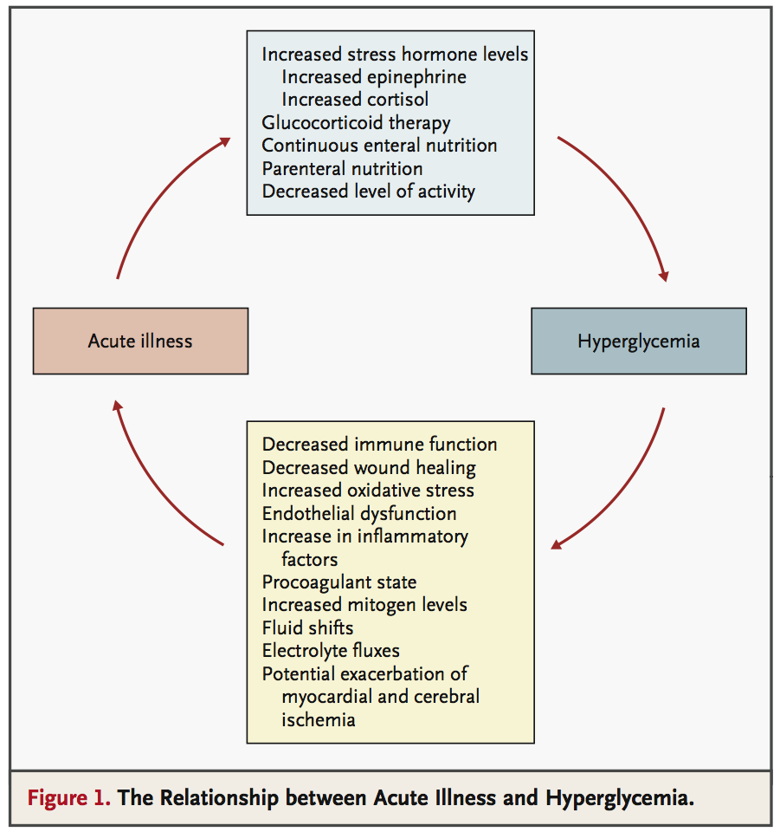

Slide 12
GLUCOSE ABNORMALITIES in hospital setting
a.Hyperglycaemia:
  Blood glucose level > 140 mg/dl (>7.8 mmol/L) in hospitalized patients.
  Hba1c % value >6.5 or more.
b.Hypoglycaemia:
when blood glucose value <3.9 mmol/l
  .

Slide 13
Diagnosis of GLUCOSE ABNORMALITIES in hospital setting
1.Random blood glucose measurement with value-
>140 mg/dl (>7.8 mmol/L)
2. HbA1c % test is performed if no hba1c % test is done in previous 3 months in diabetic patients and to exclude stress hyperglycemia.
HbA1c % > 6.5 or more.

Slide 14
GOALS OF MANAGEMENT
IN hospital setting
1.Maintaining near normoglycemia.
2.Avoidance of hypoglycemia.

Slide 15
GLYCAEMIC TARGET
IN hospital setting
a.In critically ill patients :
140 – 180 mg/dl (7.8 – 10 mmol/L)
b.In noncritical care settings:
100 – 180 mg/dl (5.6 – 10 mmol/L)
c.In selected populations [critically ill patients udergoing surgery)
110-140 mg/dl(6.1-7.8 mmol/l)
d.advanced kidney failure and/or on dialysis) or at high risk of hypoglycemia:
Upto 250 mg/dl (13.9 mmol/L.]

Slide 16
Principles of management of diabete in hospital setting
1.Assessment of risk factors and additional risk factors
2.Accurate diagnosis in hospital setting.
3.Feeding selection in the form of enteral or parenteral.
4.Calculation of insulin requirement and choice of route of administration either intravenous or subcutanious.
5.Ancilliary treatment.
6.Multidiciplinary approach.
7.Maitaining target blood glucose.
8.Close monitoring and regular follow up

Slide 17
Feedings in hospital setting
1.ENTERAL FEEDING
through oral cavity or ng tube
2.PARENTERAL FEEDING
through intravenous route

Slide 18
ENTERAL FEEDING in hospital setting
Insulin should cover basal, prandial and correctional need.
1.1 unit insulin should be given for every 10 -15 g of carbohydrate.
2.Basal or intermediate acting insulin can be given in combination with a short acting insulin every 4 – 6 hours
3.If enteral feeding is interrupted, dextrose infusion should be started immediately to prevent hypoglycaemia .

Slide 19
PARENTERAL FEEDING in hospital setting
1.Insulin in the form of short acting insulin is added to the parenteral bag.
2.A starting dose of 1 unit of regular human insulin for every 10 g of dextrose has been recommended.
3.Short acting insulin may be given as correction every 6 hours to prevent any hyperglycemia.

Slide 20
GLUCOSE LOWERING TREATMENTS IN hospital setting
a.Insulin:
Main medication to controle blood glucose in hospital setting.
b.non insulin:
There is no data on the safety and efficacy of oral agents and injectable non-insulin therapies such as GLP 1 analogs in hospital. They have a limited role during acute illness.

Slide 21
GLUCOSE LOWERING TREATMENTS IN hospital setting
indications:
Persistent hyperglycaemia with blood glucose level 10.0 mmol/l or more ,more than two occasions within 24 hours.

Slide 22
Insulin in hospital setting
Routes of insulin administration:
1.Intra venous insulin given as-
varriable rate intravenous insulin infusion.
2.Subcutanious insulin given as-
a.Intermittent subcutanious insulin injection therapy.
b.Continuous subcutanious insulin infusuion therapy through infusion pump.

Slide 23
Insulin in hospital setting
Insulin initiation adjusttment:
a.Critical care setting –
continous intravenous infusion insulin with dose-0.1 unit/kg/hour
b.Non critical care setting-
Basal insulin or basal plus bolus correction for poor oral
intake or nothing per oral with dose-0.2-0.5 unit/kg/day
Basal,prandial and correction componant for individual with
adequet nutritional intake with dose-0.2-0.5 unit/kg/day
c.Selected cases-according to situation

Slide 24
Insulin in hospital setting
Insulin dose adjustment:
Basal insulin of 10 unit/day or 0.1-0.2 unit/kg/day + bolus insulin 4 unit/day or 10% of basal dose .
Increase dose by 2-4 units every 3 days to reach the target.
Decrease dose by 2-4 units if blood sugar is below the target.

Slide 25
GLUCOSE MONITORING in hospital setting
a.For those who are eating:
CBG/POC should be performed before meals and at bedtime.
b.For those who are not eating:
CBG/POC should be performed every 4 – 6 hours.
c.For those on intravenous insulin infusion:
CBG/POC performed within every 30 mins – 2 hours.
d.Perioperative period:
Every 2-4 hours.

Slide 26
GLUCOSE MONITORING methods in hospital setting
A.Continous blood glucose monitoring with-
1.Continous blood glucose monitoring(cgm) machine
2.Automated insulin delivery system along with cgm
b.Intermittent blood glucose monitoring with-
1.Lab from venous blood
2.Glucometter from capillary blood

Slide 27
Treatmrnt
In
CRITICAL CARE SETTING
Continuous intravenous insulin infusion is given-
  Soluble insulin is used @ rate of 0.1 unit/kg/hour.
  with target blood glucose
  140 – 180 mg/dl (7.8 – 10 mmol/L)
  Blood glucose is checked in an hourly basis and dosage adjustments made targeting blood glucoe.
  1 unit insulin for 10 gm glucose for iv glucose infusion.

Slide 28
Treatmrnt in
NONCRITICAL CARE SETTING
a.Inpatients with poor oral intake or nothing by mouth –a basal plus bolus schedule is used.
  Rapid or short acting insulin is given before each meals inpatients on enteral/parenteral feeding.
  Rapid or short acting insulin is given 4 – 6 hourly if the patient is on NPO.
  dose of insulin-0.2-0.5 unit/kg/day
  With maintaining targetting blood glucose-
  100 – 180 mg/dl (5.6 – 10 mmol/L)
  blodd glucose monitor- every 4 – 6 hours

Slide 29
Treatmrnt in
NONCRITICAL CARE SETTING
  b.Inpatients with adequate nutritional intake – basal, prandial and correction components is the preferred treatment.
  Dose of insulin- 0.2-0.5 unit/kg/day
  With maintaining targetting blood glucose-
  100 – 180 mg/dl (5.6 – 10 mmol/L)
  blodd glucose monitor- every 4 – 6 hours
  1 unit insulin for 10-15 gm glucose for enteral or parenteral feeding.
  .

Slide 30
Diabetic ketoacidosis
Criteria:
1.Hyperglycaemia with blood glucose
≥11.1 mmol/L or Previous H/O DM.
2.Hyperketonaemia (≥3 mmol/L) and ketonuria .
(more than 2+on standard urine sticks)
3. Metabolic acidosis with venous bicarbonate
<15 mmol/L and/or venous pH <7.3)

Slide 31
HYPERGLYCEMIC HYPEROSMOLAR STATE
Criteria:
1.Severe hyperglycaemia with Blood Glucose level-
> 30 mmol/L (600 mg/ dL)).
2.Hyperosmolality With serum osmolality-
> 320 mOsm/kg).
3. Absence of Significant hyperketonaemia with-
S.Ketons level < 3 mmol/L) or
4.Acidosis with-
pH > 7.3, bicarbonate > 15 mmol/L

Slide 32
Insulin protocol
Regular insulin IV
0.1 U/kg b-wt
IV bolus
0.14 U/kg b-wt/hr
IV infusion
0.1 U/kg b-wt/hr
IV infusion
If plasma glucose does not fall by at least 10%
in first hour, give 0.14 U/kg IV bolus,
then continue as previous
DKA: When plasma glucose reaches 11.1 mmol/L, reduce infusion rate to 0.02-0.05 U/kg/hr.
Target plasma glucose is 8.4-11.1 mmol/L until resolution of DKA.
HHS: When plasma glucose reaches 16.7 mmol/L, reduce infusion rate to 0.02-0.05 U/kg/hr.
Target plasmaglucose is 11.1-16.7 mmol/L until patient is mentally alert.

Slide 33
Sick day management
Period of illness , fever, vomiting or diarrhea
Stop Metformin temporarily
Stop SGLT2 inhibitor to avoid ketosis and dehydration
DPP4 inhibitors can be continued
Target to maintain between 6-10 mmol /L & check BG 4 hourly
Regular exercise and physical activity should be postponed during sick days

Slide 34
CKD patients with diabetes
1.In CKD, there is increased risk of hypoglycemia while using insulin due to decreased clearance.
2.All available insulin preparations can be used in patients with CKD.
3.Usually, no dose adjustment is required for total daily dose (TDD) of insulin if the eGFR is >50 mL/min /sq body surface area.
4.Reduction to 75% of TDD of insulin when the eGFR is between 10 and 50 mL/min/sq body surface area and to 50% of TDD for eGFR of <10 mL/min/sq body area be considered which is independent of the type of insulin being used.

Slide 35
CKD patients with diabetes
5.Long acting insulin/ basal insulin analogue should be used with reduced dose during initiation and intensification.
6.Close monitoring of blood glucose and adjustment of insulin doses are required to avoid hypoglycemia.
7.Good glycemic control with SGLT2 inhibitors and GLP1-RA
8.ACE inhibitors or ARBs are preferred drugs for control of BP (<130/80 mm of hg)

Slide 36
Cld patients with diabetes
1.In CLD, short acting insulin analogues can be used just after meal if patient have nausea or reduced appetite.
2.Frequent dose adjustment and careful glucose monitoring for T2DM and CLD patients is thus very important to minimize the risk of hypoglycemia or hyperglycemia.
3. Meals should be taken every three-hourly to avoid hypoglycemia.

Slide 37
Diabetes and surgery
Principles:
1.Careful pre-operative assessment,perioperative management and post-operative assessment are manditory
2.First categories as-
a.patients with short starvation
b.patients with long starvation
3.Metformin shoud be stopped 24 hrs before day of operation
4.dpp4 inhibitors should be stopped 3-4 days before the day of operation.

Slide 38
Diabetes and surgery
4.Withheld any other oha in the morning of day of operation and start 50% dose nph insulin or 75-80 % dose of long acting analogue.
5.The blood glucose goal in the perioperative period should be 100–180 mg/dL (5.6–10.0 mmol/L) 4 hour of the surgery.
6.Blood glucose monitor 4 to 6 hourly.
7.Iv insulin continue till oral feeding.
8.Initiate subcutanious insulin when oral feeding start
9.Continue insulin until wound healing
10.Delay surgery when hba1c % is 8.5

Slide 39
Transition
From
IV Insulin to SC Insulin
IV insulin should be transitioned to SC insulin therapy if -
  1.patient is clinically stable
  2.patient is biochemically stable
  3.Patient is able to take oral food
Because of short half-life of IV insulin, SC insulin should be
administered at least 1-2 hours prior to discontinuing the
drip.

Slide 40
Transitioning
From iv insulin to sc Insulin
Subcutaneous basal insulin should be given 2 hours before intravenous infusion is discontinued, with the aim of minimizing rebound hyperglycemia.
Administration of a low dose (0.15–0.3 units/kg) of basal insulin analog in addition to intravenous insulin infusion may reduce the duration of insulin action.

Slide 41
Transitioning
From iv insulin to sc Insulin
a.From 24 hours requirent of insulin:
1.Estimate the basal SC insulin dose based on the total amount of IV insulin given in the last 6 hours.
2.Calculate the total amount of insulin given during the last 6 hours of the IV insulin infusion and multiply by 4 for an estimate of the 24-hour insulin requirement.
3.then reduce that amount by 20% for an initial SC basal insulin dose. This calculation assumes the patient was NPO while on the insulin infusion.

Slide 42
Calculating the SC Insulin Dose after iv insulin
calculate total insulin required in last 6 hrs(eg . if pt getting 2 U/hr so in last 6 hrs he got 2א6= 12 units)
So 24 hrs insulin requirement 12א4= 48 U.
80% of last 24 hrs insulin requirement given=40U/day
inj.Short acting insulin 100U 6+ 6+ 6 and
inj.Intermediate acting insulin 100U 10+ 0+10
or
Inj.Aspart 6+ 6+ 6 and
inj.Glargine 0+ 0+ 20

Slide 43
Transitioning
From iv insulin to sc Insulin
B.Based on prior home insuli n dose.
c.Following weight-based approach .

Slide 44
HYPOGLYCEMIA
Difinition:
may be difined as clinical condition with blood evel <3.9 m mol/l.
Level:
  Level 1: Blood glucose of 54 – 69 mg/dl (3.0 – 3.8 mmol/L)
  Level 2: Blood glucose of <54 mg/dl (<3.0 mmol/L)
  Level 3: Clinical event characterized by altered mental and physical functioning which requires assistance from another person for recovery.

Slide 45
Causes hypoglycaemia in hospital hypoglycemia
Overdose of insulin
Excess intake of insulin secretogogues
Delay or omission of meal
Medical cause: hepatic failure, renal failure, cardiogenic shock, severe sepsis
Surgical cause: NPO for operation
Error of insulin prescription or adminstration
Sudden reduction of ecessive amount steroid

Slide 46
TREATMENT of hypoglycaemia
a.Mild to moderate hypoglycemia:
-It is usually relived by 15 gm glucose or equivalent food. A glass of soft drink, or fruit juice.
-The food/drink is repeated every 15 minutes until the patient is stable.
-If this has been repeated 3 times, consider I/V glucose

Slide 47
TREATMENT of hypoglycaemia
b.Severe hypoglycemia:
- If patient is unconscious or very aggressive or nil by mouth, parenteral treatment is required:
  IV 75 mL 20% dextrose over 15 mins
  IV 150 mL 10% dextrose over 15 mins
  IM glucagon (1 mg) – may be ineffective in undernourished people, severe liver disease and in repeated hypoglycaemia

Slide 48
REDUCING FUTURE RISK
OF
HYPOGLYCAEMIA
Education – risk factors and treatment of hypoglycemia.
Continuous glucose monitoring is recommended for patients with level 3 hypoglycemia, recurrent hypoglycemia or patients with impaired awareness of hypoglycemia.

Slide 49
Discharge Planning
& diabetic education
1.Diabetes service is contacted for all patients new to SC insulin.
2.Discharge planning is initiated when recovery from acute illness.
3.Arrange Early Follow up.

Slide 50
Discharge Planning
& diabetic education
3.Level of understanding related to diagnosis of diabetes , SMBG and explanation of home blood glucose target.
4.Definition, recognition, treatment and prevention of hyperglycemia and hypoglycemia.
5.Information on consisting eating patterns.
6.Insulin dose adjustment.
7.Proper use of insulin syringe.

Slide 51
CONCLUSION
1.Hyperglycaemia,hyopoglycaemia and glucose variability are unpleasant and potentially harmfull and are associated with adverse outcome.
2.Hyperglycemia in a hospital setting has to be addressed to increase morbidity and mortality, however strict glycemic targets should not be achieved to prevent hypoglycemia.

Slide 52
CONCLUSION
2.In patients admitted with acute complications of diabetes mellitus, hyperglycemia as well as metabolic effects such as hyperketonemia,metabolic acidosis and hyperkalemi or hypokalemia has to be corrected.
4.Identification and careful management of people with diabetes and dysglycaemia during hospitalization has direct and immediate benefits.

Slide 53
CONCLUSION
5.In hospitalized patients with diabetes mellitus, patients should be counselled about their lifestyle, pharmacological management and possible complications with their prevention and treatment.

Slide 54


